Slide 1
Introduction to strategic planning
This programme has been funded with support from the European Commission.
Project No: 612464-EPP-1-2019-1-IE-EPPKA2-KA
Course part of the CSE Novice Module

Slide 2
Structure
1. Description
2. Didatical form and assessment method
3. Strategy
3.1. What does it mean?
4. Strategic planning
4.1. What is strategic planning?
4.2. Levels of strategic planning
5. Generic strategies model
5.1. Model and definitions
5.2. Competitive advantage versus Comparative advantage
6. Strategy stages
6.1. Product life-cycle strategies
6.2. The 10 stages of strategic planning
7. Wrapping-up: Reviewing strategic planning
Bibliography

Slide 3
1. Description
This learning unit aims at presenting down-to-earth methods for entrepreneurs to assess their resources and identify the best solutions to explore opportunities, adapt to them and create innovative solutions for their organisations. The unit explores tools that allow ideas to be developed and converted into value for the organisation and its employees. This unit invites the student to visit different perspectives by which strategy can be formulated and implemented.
Specific unit content:
Explaining strategy and strategic planning
Key elements of strategic planning
Generic strategies model
Strategic stages

Slide 4
2. Didactical form and Assessment method
1 ECTS
Case study driven methodology, including case-study based group and application of tools and frameworks to cases.
Lecturer observation and questioning.

Slide 5
3. Strategy | 3.1. What does it mean?
Strategy as a set of practices involving:
power
ethics
organisational cultures
national cultures
resources
communication
(…)

Slide 6
4. Strategic planning | 4.1. What is strategic planning?
the process of perceiving new positions that woo customers from established positions or draw new customers into the market.
A set of guiding principles that, when communicated and adopted in the organization, generates a desired pattern of decision making. A strategy is therefore about how people throughout the organization should make decisions and allocate resources in order accomplish key objectives.
The making of an integrated set of choices that collectively position the firm in its industry so as to create sustainable advantage relative to competition and deliver superior financial returns.

Slide 7
4. Strategic planning | 4.1. What is strategic planning?
Stationary documents focusing on budget
Planning
A set of strategies
Martin (2013)

Slide 8
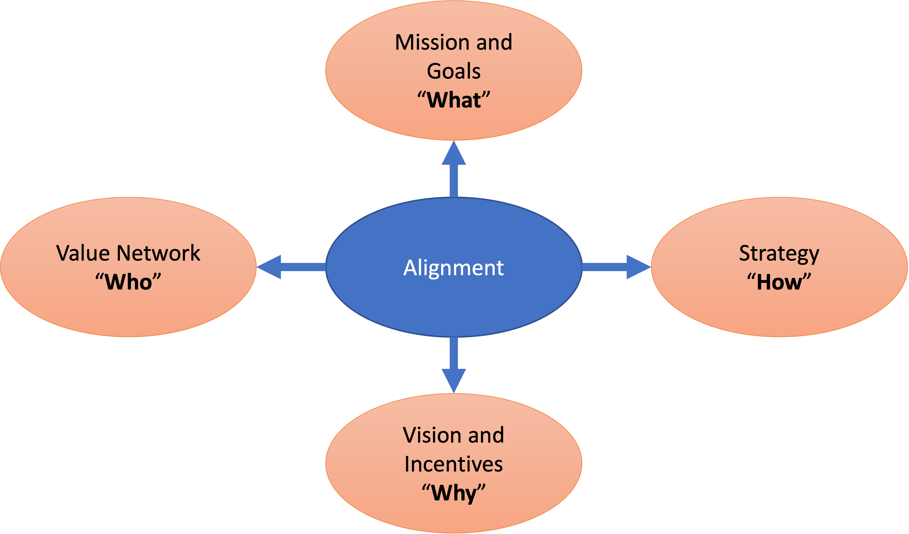
4. Strategic planning | 4.1. What is strategic planning?
THE BASE

Slide 9
4. Strategic planning | 4.2. Levels of strategic planning
Strategic planning: involving the entire organisation
Tactical planning: involving selected areas of the organisation
Operational plan: providing resource allocation to each part of tactical plans
ACKOFF (1999)

Slide 10
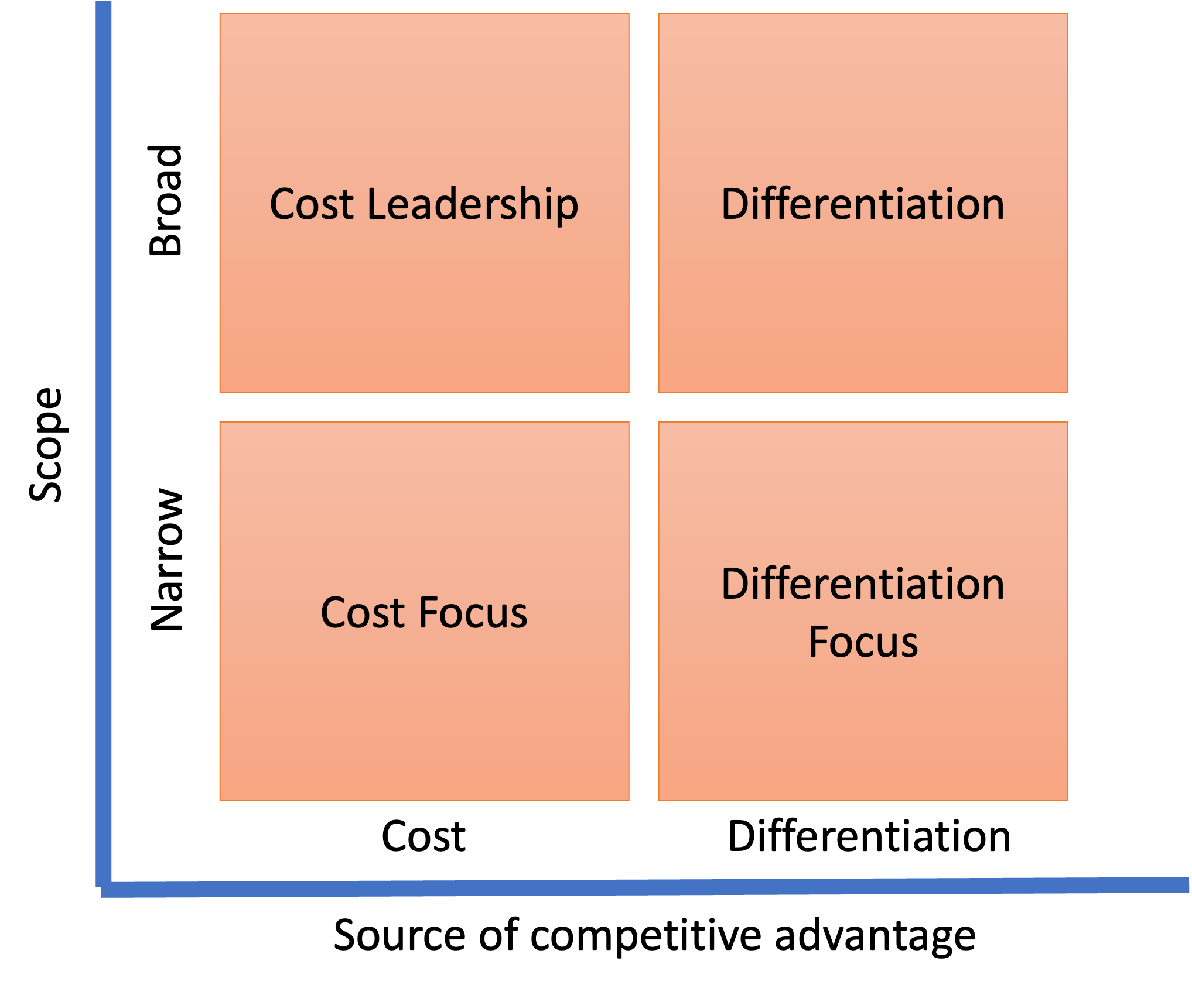
5. Generic strategies model | 5.1. Model and definitions
Porter, 1985

Slide 11
5. Generic strategies model | 5.1. Model and definitions
Cost Leadership: maintaining the lowest cost of operation in the industry by either (i) increasing profits by reducing costs and keeping prices; or (ii) increasing market share by reducing costs and prices
Differentiation: producing different and better products
Cost Focus: focusing on a niche market and developing low-cost products
Differentiation Focus: focusing on a niche market and developing different and better products

Slide 12
5. Generic strategies model | 5.2. Competitive advantage versus Comparative advantage
Comparative advantage
The ability of an organisation to produce and deliver products more efficiently than a competitor, leading to better profit
Competitive advantage
The different aspects that enable the organisation to produce more attractive or cheaper products than the competition
A competitive advantage exists if the organisation outperforms in different aspects, including cost structure, branding, quality differentials, distribution and customer service
Based on the core competences of the organisation

Slide 13
5. Generic strategies model | 5.2. Competitive advantage versus Comparative advantage
Core competences of the organisation
Whatcan the organisation do better (activities and procedures) than any other.
The activity provides superior values or benefits to the consumer
It is difficult to be copied by the competition
It is rare in the market

Slide 14
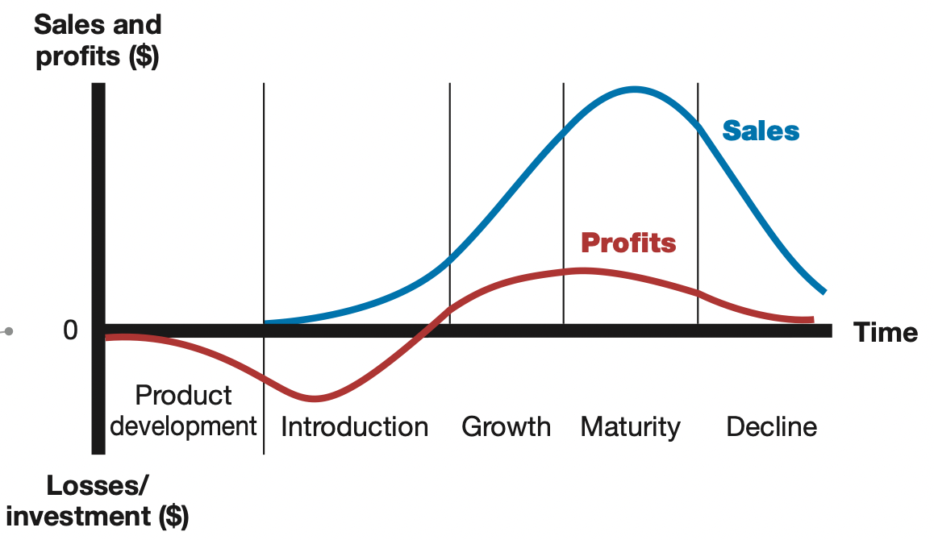
6. Strategy stages | 6.1. Product life-cycle strategies
What are the product life-cycle stages?
Introduction: a new product is first distributed and made available for purchase
Growth: the product’s sales are quickly climbing
Maturity: the product’s sales grow slowly or level off
Decline: the product’s sales fade away

Slide 15
6. Strategy stages | 6.1. Product life-cycle strategies
1) The introduction stage
Characteristics: Low sales, High cost per customer, Profits are negative, Customers are innovators, and Competitors are few
Objective: create product engagement and trial

Slide 16
6. Strategy stages | 6.1. Product life-cycle strategies
1) The introduction stage
Objective: create product engagement and trial
Possible strategies:
Product: offer a basic product
Price: use cost-plus
Distribution: build selective distribution
Advertising: build product-awareness among early adopters and dealers
Sales promotion: use heavy sales promotion to entice trial

Slide 17
6. Strategy stages | 6.1. Product life-cycle strategies
2) The growth stage
Characteristics: Rapidly raising sales, Average cost per customer, Rising profits, Customers are early adopters, and Competitors are in growing numbers
Objective: maximize market share

Slide 18
6. Strategy stages | 6.1. Product life-cycle strategies
2) The growth stage
Objective: maximize market share
Possible strategies:
Product: offer product extension, service and warranty
Price: price to penetrate market
Distribution: build intensive distribution
Advertising: build engagement and interest in the mass market
Sales promotion: reduce to take advantage of heavy consumer demand

Slide 19
6. Strategy stages | 6.1. Product life-cycle strategies
3) The maturity stage
Characteristics: Peak sales, Low cost per customer, Declining profits, Customers are mainstream adopters, and Number of competitors is stable, beginning to decline
Objective: maximize profit while defending market share

Slide 20
6. Strategy stages | 6.1. Product life-cycle strategies
3) The maturity stage
Objective: maximize profit while defending market share
Possible strategies:
Product: diversify brand and models
Price: price to match or beat competitors
Distribution: build more intensive distribution
Advertising: stress brand differences and benefits
Sales promotion: increase to encourage brand switching

Slide 21
6. Strategy stages | 6.1. Product life-cycle strategies
4) The decline stage
Characteristics: Declining sales, Low cost per customer, Declining profits, Customers are lagging adopters, and Competitors are in declining numbers
Objective: reduce expenditure and milk the brand

Slide 22
6. Strategy stages | 6.1. Product life-cycle strategies
4) The decline stage
Objective: reduce expenditure and milk the brand
Possible strategies:
Product: phase out weak items
Price: cut price
Distribution: go selective: phase out unprofitable outlets
Advertising: reduce the level to retain hard-core loyals
Sales promotion: reduce to minimal level

Slide 23
6. Strategy stages | 6.1. The 10 stages of strategic planning
Mission statement: purpose of the organisation including what and how it aims to achieve – what is the importance for the existence of the organisation?
Vision statement: what will the organisation look like in five or more years
Values statement or guiding principles: the core beliefs that represent the essence of the organisation
Mission statement: purpose of the organisation including what and how it aims to achieve – what is the importance for the existence of the organisation?
Vision statement: what will the organisation look like in five or more years
Values statement or guiding principles: the core beliefs that represent the essence of the organisation
Strategies: the general umbrella methods used to reach the organisation’s vision
Short-term goals: the strategic objectives are divided into specific performance targets that will be met in each year, stating what, when, how and who.
Action items/plans: explain how a goal will be accomplished (executed by selected teams or individuals), with details by intervals of one to two years.
Financial assessment: based on historical record and future projections, helps to plan ahead with control over performance.
(Olsen, 2011)

Slide 24
7. Wrapping up: Reviewing strategic planning
By accomplishing the 10 stages of strategic planning, the organisation must have clearly declared and answered the following questions:
Where we are?
Where are we going?
How will we get there?
(Olsen, 2011)

Slide 25
Bibliography
Ackoff, R. L. (1999) Re-creating the Corporation: A Design of Organizations for the 21st Century. Oxford University Press, USA.
Kotler, P., and Armstrong, G. (2010). Principles of marketing. Pearson education.
Martin, R.L. (2013) Don’t let strategy become planning. Harvard Business Review, Feb. Available at https://hbr.org/2013/02/dont-let-strategy-become-plann?ab=at_art_art_1x1
Olsen, E. (2011) Strategic planning kit for dummies, 2nd Edition. John Wiley & Sons.
Porter, M. E. (1996). What is strategy? Harvard Business Review, Nov-Dec.
Porter, M.E. (1985) Competitive advantage: creating and sustaining superior performance.
Prahalad and Hamel (1990) The core competences of the corporation, Harvard Business Review, May-June.
Watkins, M.D. Demystifying strategy: the what, who, how, and why. Harvard Business Review. Available at https://hbr.org/2007/09/demystifying-strategy-the-what
(Olsen, 2011)

