Slide 1
Finance for Social Business
Learning Unit Topics & Content (Module Professional)
This programme has been funded with support from the European Commission.
Project No: 612464-EPP-1-2019-1-IE-EPPKA2-KA

Slide 2
Learning Unit Content Overview
Investment/Financial Strategy
Identifying financial needs and outlining a fundraising strategy
Value proposition & social impact investment
Choosing the Right Path
Recognizing options and opportunities
Advantages and challenges of external funding/support
Digital Fundraising
Donations
Crowdfunding
Offline Financing
Grants (public funds)
Private investment (impact investors, business angels)
Credit financing
Notes:
Startup. Deliverable Learning unit 2:
Fundraising strategy, identifying needs, specifying the methods of fundraising and fundraising campaigns (online and offline).
Marketing plan.
Potential opportunities for social finance and the social impact expected.
Unten steht: Specific learning unit content:
Social business economy
Analyse stages of social entrepreneurship and potential opportunities of social finance.
Digital Marketing
Fundraising strategy.
Value proposition & Social Impact Investment.

Slide 3
Learning Unit Goals & Objectives
Learning Goal
Learners understand the opportunities of social entrepreneurship, social business, and non-profit-organizations.
Instructional Objectives
Learners will be taught the basics of financial strategy, marketing and fundraising.
Learning Objectives
Learners are able to name and explain basic steps for developing a financial/investment strategy including concrete options for on- and offline fundraising and marketing activities.

Slide 4
Topic 1: Financial Planning
Identifying needs and outlining a fundraising strategy
Value proposition & social impact investment
Notes:
How to Spend Your Startup’s Initial Investment (capterra.com)
How to Spend Your Startup’s Initial Investment (linkedin.com)

Slide 5
Topic 1: Goals & Objectives
Learning Goal
Learners understand the purpose of and how to develop a financial strategy and basic guidelines for spending an initial investment
Instructional Objectives
Learners will be taught what it means to invest in their own startup (or non-profit) and the basics of creating a financial strategy
Learning Objectives
Learners will be able to identify key areas for investment in starting up a business or non-profit
Learners will be able to use online tools to create a financial plan

Slide 6
What is a financial plan?
A financial plan is an overview of your current business financials and projections for growth. Think of any documents that represent your current monetary situation as a snapshot of the health of your business and the projections being your future expectations.
Components of a financial plan
Profit and loss statement
Cash flow statement
Balance sheet
Sales forecast
Personnel plan
Business ratios and break-even analysis
Make financial planning a recurring part of your business
Notes:
Source: How to Write a Financial Plan for Your Small Business — 2022 Guide
6 Steps to Write a Comprehensive Financial Plan for Your Small Business (bplans.com)

Slide 7
Why is a financial plan important?
A financial plan is a snapshot of the current state of your business. The projections, inform your short and long-term financial goals and gives you a starting point for developing a strategy.
It helps you, as a business owner, set realistic expectations regarding the success of your business. You’re less likely to be surprised by your current financial state and more prepared to manage a crisis or incredible growth, simply because you know your financials inside and out.
And aside from helping you better manage your business, a thorough financial plan also makes you more attractive to investors. It makes you less of a risk and shows that you have a firm plan and track record in place to grow your business.
Notes:
Source: How to Write a Financial Plan for Your Small Business — 2022 Guide
6 Steps to Write a Comprehensive Financial Plan for Your Small Business (bplans.com)

Slide 8
Financial Planning
Financial Plan Templates: https://www.examples.com/business/business-financial-plan-template-examples.html
Steps for writing a financial plan: 6 Steps to Write a Comprehensive Financial Plan for Your Small Business (bplans.com)
5 Tips to build a solid Financial Strategy for your Startup: 5 Tips to build a solid Financial Strategy for your Startup | by IOOGO Inc. | Medium

Slide 9
What is a financial strategy?
A good financial strategy combines financial planning and strategic planning, promoting achievement of goals through careful, planned investment.
https://www.batonglobal.com/post/how-to-write-mission-vision-and-values-statements-with-examples#:~:text=The%20mission%20statement%20communicates%20the,organization's%20core%20principles%20and%20ethics.

Slide 10
What is an investment?
An investment is an asset or item acquired with the goal of generating income or appreciation. Appreciation refers to an increase in the value of an asset over time. When an individual purchases a good as an investment, the intent is not to consume the good but rather to use it in the future to create wealth.​
An investment always concerns the outlay of some capital today—time, effort, money, or an asset—in hopes of a greater payoff in the future than what was originally put in.
An investment involves putting capital to use today in order to increase its value over time.​
An investment requires putting capital to work, in the form of time, money, effort, etc., in hopes of a greater payoff in the future than what was originally put in.​
An investment can refer to any medium or mechanism used for generating future income, including bonds, stocks, real estate property, or a business, among other examples.
https://www.investopedia.com/terms/i/investment.asp

Slide 11
Available for Investment
Understanding that investment can take many shapes enables businesses to take advantage of a variety of resources. Considering all available investment resources when developing a financial plan promotes optimal use of financial resources.
What resources can be invested?
Time
Physical assets
Money

Slide 12
How to spend your startup‘s initial investment
One of the keys to spending wisely is in treating the money you have – no matter where it came from – like it’s your money. Bootstrappers often talk about the way spending your own hard-earned cash makes you rethink the quality of every investment. This is a healthy mindset toward investment.
Let me propose the following breakdown of how to spend the money you’ve got, be it $1 million or $10,000.
Up to 20% on market research
At least 75% on building your minimum viable product
Whatever’s left over on the rest of the stuff that seems important at the time
Notes:
How to Spend Your Startup’s Initial Investment (capterra.com)

Slide 13
Material
Why investors are not interested: https://www.youtube.com/watch?v=IK7HkSp1KBI
Pitch to a venture capitalis: https://www.ted.com/talks/david_s_rose_how_to_pitch_to_a_vc
How to choose the right investor: https://www.zenbusiness.com/blog/choosing-right-investors-startup/
https://www.entrepreneur.com/article/371684

Slide 14
How an investment works
The act of investing has the goal of generating income and increasing value over time. An investment can refer to any mechanism used for generating future income. This includes the purchase of bonds, stocks, or real estate property, among other examples. Additionally, purchasing a property that can be used to produce goods can be considered an investment.​
In general, any action that is taken in the hopes of raising future revenue can also be considered an investment. For example, when choosing to pursue additional education, the goal is often to increase knowledge and improve skills (in the hopes of ultimately producing more income).
Because investing is oriented toward the potential for future growth or income, there is always a certain level of risk associated with an investment. An investment may not generate any income, or may actually lose value over time. For example, it's also a possibility that you will invest in a company that ends up going bankrupt or a project that fails to materialize. This is the primary way that saving can be differentiated from investing: saving is accumulating money for future use and entails no risk, whereas investment is the act of leveraging money for a potential future gain and it entails some risk.
More Risk?

Slide 15
Types of Investmenters
Angel Investors:
Are wealthy individuals that are focused on financing small businesses in exchange for equity. These investments come from their private net worth.
Peer-to Peer lenders
It's when companies can borrow money directly from people instead of banks. Lenders can then bid their loans by offering an interest rate and borrowers can accept the offers more suitable for their interest. Online there are platforms for lenders and borrowers.
Venture Capitalists
Are good when your business needs a large amount of business capital. Venture capitalists do not use their own money but work for firms that invest into smaller and larger businesses.
Private Equity Investors:
Are individuals that invest their private equity. In return they want a percentage of the profit or a part in the company.
Notes:
How to choose the right investor: https://www.zenbusiness.com/blog/choosing-right-investors-startup/

Slide 16
1.2 Value proposition & Social Impact Investment
What is a value proposition?
A company's value proposition tells a customer the number one reason why a product or service is best suited for that particular customer.
A value proposition should be communicated to customers directly, either via the company's website or other marketing or advertising materials.
Value propositions can follow different formats, as long as they are "on brand," unique, and specific to the company in question.
A successful value proposition should be persuasive and help turn a prospect into a paying customer.
https://www.investopedia.com/terms/v/valueproposition.asp
Understand Value:
https://www.bain.com/insights/elements-of-value-interactive/
Notes:
-> to

Slide 17
Value Proposition
What is the purpose of a value proposition?
A value proposition is meant to convince stakeholders, investors, or customers that a company or its products/services are worthwhile. If the value proposition is weak or unconvincing it may be difficult to attract investment and consumer demand.
What is an employee value proposition?
An employee value proposition (EVP) applies to the job market. Here, a company that is hiring will try to frame itself as a good place to work, offering not only monetary compensation but also a range of benefits, perks, and a productive environment. In return, the job candidate will need to convince the hiring company that they have the appropriate skills, experience, demeanor, and ambition to succeed.
What happens if a value proposition fails?
If a company cannot convince others that it has value or that its products or services or valuable, it will lose profitability and access to capital and may ultimately go out of business.

Slide 18
Value Proposition Canvas
The Value Proposition Canvas is a business model tool that helps companies to identify if their product or service is targeting the customer and is positioned around their needs and values.
Notes:
Add link to video that clarifies this …https://www.strategyzer.com/canvas/value-proposition-canvas

Slide 19
Impact Investment
Impact investing is a general investment strategy that seeks to generate financial returns while also creating a positive social or environmental impact.
Investors who follow impact investing consider a company's commitment to corporate social responsibility or the duty to positively serve society as a whole.
Socially responsible (SRI) and environmental, social, and governance (ESG) investing are two approaches to impact investing, although there is still some disagreement over terminology in the investing community.
https://www.investopedia.com/terms/i/impact-investing.asp

Slide 20
Social Impact Investment
Socially responsible investing is the practice of investing money in companies and funds that have positive social impacts.
Socially responsible investing has been growing in popularity in recent history.
Investors should keep in mind that socially responsible investments are still investments and be sure to weigh the potential for return into their decisions.
Community investing is a type of investing where the return is measured on community impact rather than monetary return.
Socially responsible investments tend to mimic the political and social climate of the time.

Slide 21
1.3 Marketing Strategy
The marketing plan details the strategy that a company will use to market its products to customers.
The plan identifies the target market, the value proposition of the brand or the product, the campaigns to be initiated, and the metrics to be used to assess the effectiveness of marketing initiatives.
The marketing plan should be adjusted on an ongoing basis based on the findings from the metrics that show which efforts are having an impact and which are not.
Digital marketing shows results in near real-time, whereas TV ads require rotation to realize any level of market penetration.
A marketing plan is part of a business plan, which describes all of the important aspects of a business, such as its goals, values, mission statement, budget, and strategies.
Notes:
https://www.investopedia.com/terms/m/marketing-plan.asp#toc-what-is-a-marketing-plan

Slide 22
Would crowdfunding be a good marketing option?
You are at home in the world of social media and have existing social networks via Facebook, Twitter, LinkedIn or other websites.
You want to raise $1 million or less this way.
You have an idea that you can clearly communicate to your friends, family, and other potential supporters.
Your idea solves a problem and therefore has a target market that you can define in your pitch.
You are prepared to be transparent with potential investors about who you are, why you are excited about this idea, and why you know you can succeed.

Slide 23
Investment Pitch - Checklist
Tell potential investors about your idea or concept at networking events or other conversations.
Before you tell a potential investor about your idea, you should have been in contact with them or have met them before (business network).
Business events, start-up fairs, meetings, LinkedIn are good ways to make first contacts.
Make sure your business is in its best state. (website, social media, mission, vision and value statement)
Know your numbers, processes and details
Have your own story that makes your business/idea unique
Share your personal background and experiences
Be as transparent and honest with your potential investors (don't lure them with false promises)
An elevator pitch is a slang term that refers to a brief speech that outlines the idea for a product, from venture capitalists and angel investors. service, or project.
An elevator pitch gets its name from the notion that the speech should be short—no longer than the time period of an elevator ride—or about 30 to 60 seconds long.
The objective of an elevator pitch is to pique the listener's curiosity enough for them to take any action, such as asking for more information or scheduling a follow-up meeting.
Project managers, salespeople, and job seekers use elevator pitches as a way of marketing themselves, their products, or their ideas.
Entrepreneurs use elevator pitches to help obtain Start-up capital

Slide 24
Elevator Pitch

Slide 25
4 Ps of Marketing
Notes:
From TrENDI pp of Marketing

Slide 26
Online vs Offline marketing
Pro Online Marketing | Con Online Marketing
Easy to measure | Depending on technology
Long-Term exposure | Worldwide competition
Easy to target key audience | Customers often ignore online ads
Affordable | Limited face to face contact
Greater reach
Pro Offline Marketing | Con Offline Marketing
Provides customers with something tangible | Difficult to measure
Built relationship while networking | Only runs for a short period of time
Reach audience when they are attentive | High costs
Greater creativness | Limited Accessibility
Notes:
https://latana.com/post/online-vs-offline-brand-marketing/

Slide 27
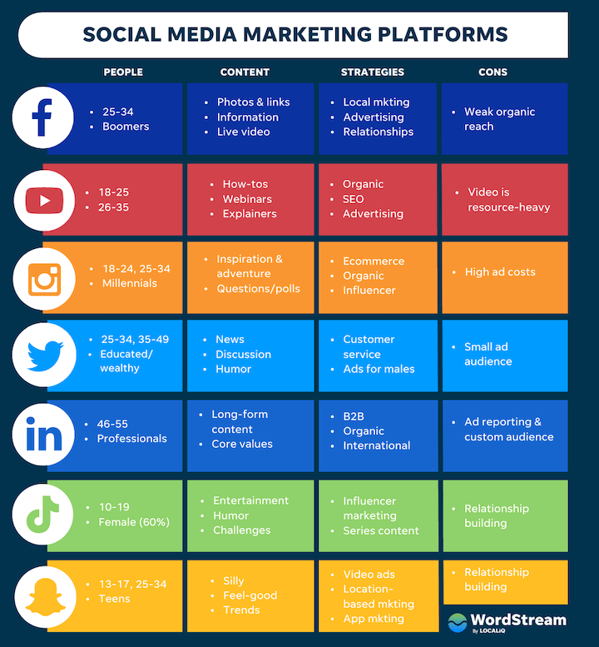
Social Media Marketing and the different channels
Social Media gives a Start-up a cheap, fast and easy opportunity to connect with people and customers.
It is important to take time to identify the target audience and tailor a social media campaign appropriately…
Do‘s and don‘ts
https://www.forbes.com/sites/forbescommunicationscouncil/2020/07/20/the-dos-and-donts-of-social-media-marketing-in-2020/
https://www.wordstream.com/social-media-marketing

Slide 28
2 types of Social Media Communication
Proactive communication
All activities are initiated from the company
The communication starts with the company
The goal is to deliver an opportunities from groups to feel engaged and addressed. Due to interest customers will react.
Reactive communication
The customer is searching for the interaction
React to interviews, posts and comments
Collecting similar questions from customers and answer them collectivly.

Slide 29
Assessment
Name two pros and cons for each online and offline marketing
What are the three sources that can be invested?
What components go into a financial plan?

Slide 30
Topic 2: Choosing the Right Financial Path
Knowing the options for financing a business or generating donations for a non-profit along with their associated advantages and disadvantages will inform the decision-making process on who and how to engage with external organisations or individuals for financial support.
Recognizing options and opportunities
Overview of financial options
Ask the right questions
Advantages and challenges of external financial support
Whether the goal is to start-up a non-profit or a business, it is important to know the what to expect from external financial support.

Slide 31
Topic 2: Goals & Ojectives
Learning Goals
Learner understands the value of a decision-making process in identifying where to pursue financial support for a social business or non-profit organisation.
Instructional Objectives
Learners will be introduced to three initial steps toward getting informed and making decisions on which kind of funding is right for one‘s endeavor.
Learning Objectives
Learner will be able to name three primary fund sources.
Learner will be able to ask key questions for good decision-making.
Learner will be familiar with the pros and cons of each fund source.

Slide 32
Overview of Options & Opportunities
Options for financing a new venture fall into three main categories:
Self-funding
Most startups begin with their own savings.
READ: Self-Financing Your Startup (entrepreneur.com)
Friends & Family
Our closest contacts are often the first to buy into our business ideas.
READ: Getting Seed Funding from Friends and Family the right way (jonathanhung.com)
Fools
Sooner or later, most businesses look externally for funding options.
Banks
Investors
Fundraising
Grants
WATCH
Founder Series 2020: Finding the Right Financing For Your Startup - YouTube

Slide 33
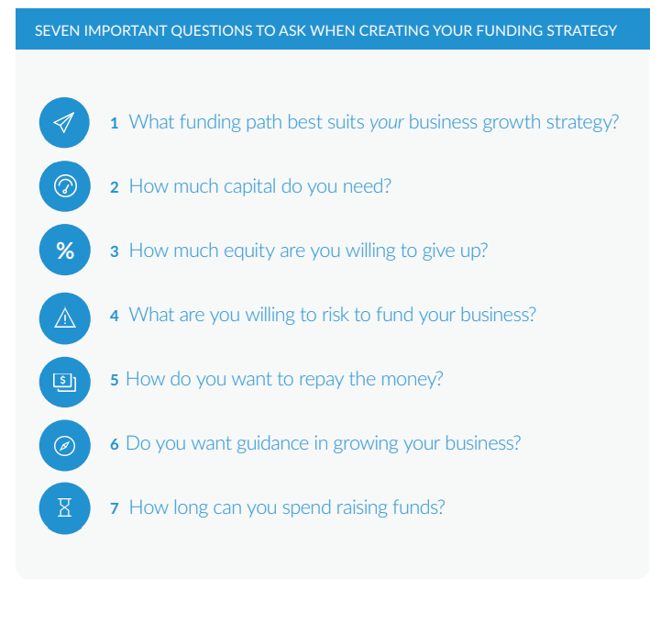
Ask the right questions
Seven important questions to ask when creating a funding strategy:
READ
How to Choose the Best Funding Path for your Startup - LighterCapital
Notes:
HOW TO CHOOSE THE BEST FUNDING PATH FOR YOUR STARTUP // © COPYRIGHT 2015 LIGHTER CAPITAL – See for more great graphics!

Slide 34
What funding path best suits your business growth strategy?
The growth trajectory you envision for your business should have a major influence on your funding strategy. You should know what you want the business to look like in one, five, and 10 years before you make decisions on what type of funding makes sense.
Source: How to Choose the Best Funding Path for your Startup, Lighter Capital, 2015

Slide 35
How much capital do you need?
A well-thought-our business plan and capital-raising strategy can help you figure out how much capital you need. Your business plan should tell you what your growth milestones are in 6 months, 1 year, and 3 years. Then figure out what you need to do and how much it will cost you to go from one milestone to the next.
Be aware of the pitfalls of raising too much money
The more you raise, the more you need to pay back
Easy money can take you off-track
You might not be ready for rapid growth
Source: How to Choose the Best Funding Path for your Startup, Lighter Capital, 2015

Slide 36
How much equity are you willing to give up?
If you are looking to remake a market and need millions of dollars to scale, the venture capital path is likely to be the only route to get you the firepower you need. In this scenario, you will likely need to give up 10 to 45% of equity in exchange for the big infusion of capital you require.
If you are looking to build a more modest company without a $1 billion exit but with recurring revenues and clear paths to profitability, it might be smarter to first explore debt options that don‘t dilute equity.
Even if you plan to eventually raise venture capital, growing your company beforehand can also improve your company‘s valuation, which means you will need to give up less equity for the amount of funding you raise.
Source: How to Choose the Best Funding Path for your Startup, Lighter Capital, 2015

Slide 37
What are you willing to risk to fund your business?
Personal financial risk
Traditional loans might require proof of phyisical assets as collateral before approving a loan. This could put savings or personal property at risk.
Loss of control
When giving up equity in your company, contol over decision-making can be diluted
Traditional bank loans have fewer strings attached, but may impose limitations on how a loan may be spent
Risks to personal relationships
Personal connections that invest in your business may not be prepared to stay invested over the long-term. An exit plan for such instances can help prevent strain on important relationships
Source: How to Choose the Best Funding Path for your Startup, Lighter Capital, 2015

Slide 38
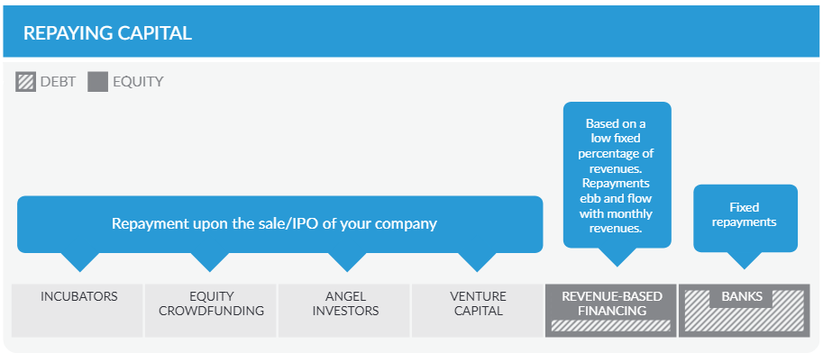
How do you want to repay the money?
Most financing requires not only repayment, but also interest.
Fixed payments
Must be paid on-schedule, regardless of how profitable your business is
Revenue-based financing
Repayment based on the ebb and flow of a businesses revenue
Expectations
The fine print
Source: How to Choose the Best Funding Path for your Startup, Lighter Capital, 2015

Slide 39
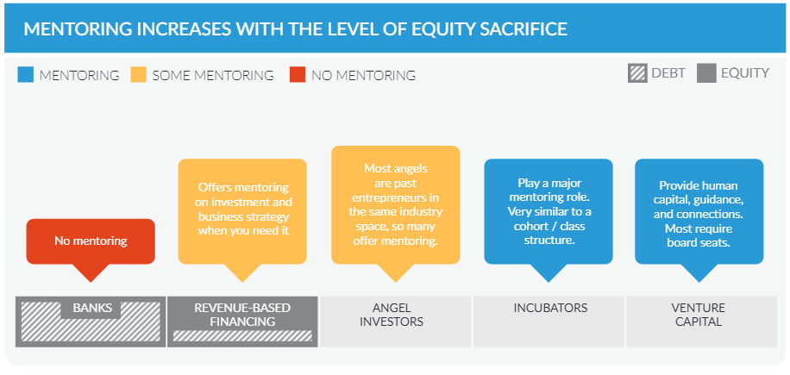
Do you want guidance in growing your business?
Who makes decisions
Who influences decisions
Who has control
Source: How to Choose the Best Funding Path for your Startup, Lighter Capital, 2015

Slide 40
How long can you spend raising funds?
Time spent chasing money is time not spent running your business. Before you seek financing, consider how long it will take to raise funds and how much of a distraction it will be. How much time will you spend courting potential investors? How much time will you spend gathering financials and filling out paperwork for a traditional bank loan? Can your business thrive while the CEO is out raising funds for an extended period of time?
Source: How to Choose the Best Funding Path for your Startup, Lighter Capital, 2015

Slide 41
Advantages of External Financial Support
Preserving Your Resources​
One of the advantages of external funding is it allows you to use internal financial resources for other purposes. If you can find an investment that has a higher interest rate than the bank loan your company just secured, it makes sense to preserve your own resources and put your money into that investment, using the external financing for business operations. You can also set aside your internal financial resources for cash payments to vendors, which can help improve your company's credit rating.
Growth​
Part of the reason organizations use external funding is it allows them to finance growth projects the company could not fund on its own. For example, if your business is growing to the point that you need additional manufacturing space to keep pace with demand, external financing can help you get the funding you need to build your addition. External funding can also be used for making large capital equipment purchases to facilitate growth that the company cannot afford on its own.
Advice and Expertise
Organizations willing to finance your business can often also be useful sources of expert advice. Your banker, for example, has funded many other small businesses and may be able to offer guidance as to how to avoid pitfalls that created problems for some. An investor in your technology start-up likely has technology expertise of his own to offer, and even if not, may be able to steer you towards useful sources of advice.
Notes:
Reading: ​
https://smallbusiness.chron.com/advantages-disadvantages-external-financing-10033.html

Slide 42
Challenges of External Financial Support
​
Ownership​
Some sources of external financing, such as investors and shareholders, require you to give up a portion of the ownership in your company in exchange for the funding. You may get that large influx of cash you need to launch your new product, but part of the financing agreement is the investor is allowed to vote on company decisions. This can compromise the vision you originally had for your company when you founded it.
Interest​
External funding sources require a return on their investment. Banks will add interest to a business loan, and investors will ask for a rate of return in the investment agreement. Interest adds to the overall cost of the investment and can make your external funding more of a financial burden than you had originally planned.
It's a Lot of Work
Securing external funding can be a nearly full-time job in its own right. You're faced with the task of identifying potential sources of funding, preparing a slick business plan, practicing a presentation, and calling dozens of people to arrange – or try to arrange – a face-to-face meeting. All of these tasks take a good deal of time and resources. None of them are a guarantee that you'll get the funds you're seeking.
Notes:
Reading: ​
https://smallbusiness.chron.com/advantages-disadvantages-external-financing-10033.html

Slide 43
Assessment
Name three typical sources of financing for a new business?
Name four important questions to ask when considering what type of financing to pursue.
Name two advantages and two challenges associated with aquiring external financial support.

Slide 44
Individual & Group Evaluation
Individual
Develop a financial strategy for a food startup with a goal of distributing within a 100 km radius within one year, based on your current financial situation.
Group

Slide 45
Next Steps
Once a decision has been reached, it is time to get started. The following sections of this learning unit will prepare you to:
Take advantage of online tools and current trends for engaging with potential financial partners and supporters for successful digital fundraising
Proceed with offline options for financing a business or non-profit venture

Slide 46
Topic 3: Digital Fundraising
What is digital fundraising?
Digital fundraising is about using all the digital channels at your disposal in an integrated way to reach and expand your audiences, spark engagement, and grow your giving opportunities.
Developing a digital fundraising strategy is particularly helpful to reach beyond your local community and engage a broader audience interested in supporting your cause.
WATCH:
10 Strategies for Success with Digital Fundraising

Slide 47
Topic 3: Goals & Objectives
Goals & Objectives
Learning Goals
Learners understand the role of digital fundraising as a tool to support social businesses and startups
Instructional Objectives
Learners will be taught what digital financing is, why it is important, what options are available, and how to get started
Learning Objectives
Learners are able to identify, understand and puruse funding via digital means​

Slide 48
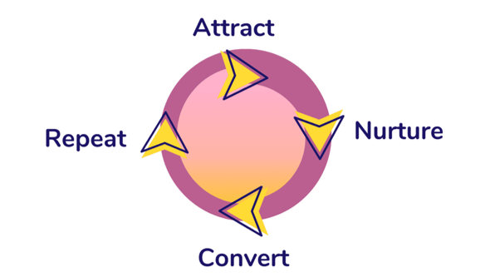
Methodology
The Digital Fundraising Methodology contains three main steps: ​
1) Attract
2) Nurture
3) Convert
Source: CauseVox
Notes:
Digital Fundraising for Nonprofits and Charities | CauseVox

Slide 49
Benefits of Digital Fundraising
Benefits of Digital Fundraising Methodology​
Improve Retention​
Reduce Workload​
Increase Acquisition​
Enhance Adaptability
READ (Chapter 3: Benefits of using technology for fundraising)
ECNL Comparative research on digital fundraising 2021 FINAL.pdf

Slide 50
Examples of Digital Fundraising
Homepage/website – Salvation Army
Crowdfunding – best platforms of 2022
Online fundraising – use a service like JustGiving
Social media – facebook, instagram, etc.
Text donations – Whole Whale (top in 2022)
Online gaming – what it‘s all about
Email – 9 tips for success
List Source: What is digital fundraising? | Synopsis (cultural-storytelling.eu)
Notes:
What is digital fundraising? | Synopsis (cultural-storytelling.eu)

Slide 51
Did you know…
​
“ In 2021, the social sector mastered the art of resilience. We saw countless organizations craft donation experiences that not only sustained a year-plus pandemic but set new standards for fundraising excellence.”
-Elizabeth McDonough, Classy

Slide 52
5 Fundraising Trends in 2022
Flexible giving options
Personalized donor experiences
Tech-driven events
Evolved recurring giving
Community through workplace giving
Reading: ​
https://learning.candid.org/resources/blog/five-fundraising-trends-to-capitalize-on-in-2022/

Slide 53
Trend 1: Flexible Giving Options
Flexible donation options include:​
Convenient digital wallets, like Google Pay and ApplePay​
Cryptocurrency donations​
Trusted payment apps, like PayPal and Venmo
There’s also growing enthusiasm around giving through QR codes, smartwatches, and wearables.​
Data from Classy’s annual Why America Gives report shows that donors are completing more donations on their mobile devices than ever before.

Slide 54
Trend 2: Personalized Donor xperiences
Personalization is critical to building relationships that result in loyal donor bases.
Nonprofit interactions with supporters need to be tailored according to their stage of life, intent, and preferences for communication.
Customized donation forms
Segment donors
Matching gift tools
Appeal to donor‘s interests
Special events and campaigns

Slide 55
Trend 3: Tech-driven Events
Hybrid events benefit both in-person and virtual attendees with advanced, tech-driven experiences that take lessons from the many virtual events staged during the pandemic.​
For national non-profits, hybrid is a way to stay frictionless. For local organizations, hybrid events can open new opportunities to enhance donor relations.
Technology-driven experiences will continue to bring causes beyond their physical city borders.

Slide 56
Trend 4: Evolved Recurring Giving
Recurring giving accounts for 26% of online revenue for organizations that raise over $50 million in total donation volume on Classy, as noted in The State of Modern Philanthropy.
The technology is simple, and the impact of just a handful of recurring donations made, tracked, and nurtured online can mean sustainable income for years ahead without requiring additional resources.
READ
Donor Retention and Recurring Giving (donorsnap.com)
Notes:
eBook: NFG-Recurring-Giving-Guide.pdf (fundraising123.org)

Slide 57
Trend 5: Community through Workplace Giving
Employee engagement programs and the heightened desire to make an impact are leading people to look for more purpose in their day to day.
Nonprofits and new startups can meet the moment by bringing their missions to workplaces knowing that donors are likely to find out about new causes through word of mouth within their close circles.
WATCH
What is workplace and employee giving?
https://youtu.be/ICaZXq74Y9Y

Slide 58
Spotlight: Crowdfunding
Crowdfunding has created the opportunity for entrepreneurs to raise hundreds of thousands or millions of dollars from anyone with money to invest. Crowdfunding provides a forum to anyone with an idea to pitch it in front of waiting investors.

Slide 59
What is crowdfunding?
Crowdfunding is the use of small amounts of capital from a large number of individuals to finance a new business venture.
Crowdfunding makes use of the easy accessibility of vast networks of people through social media and crowdfunding websites to bring investors and entrepreneurs together, with the potential to increase entrepreneurship by expanding the pool of investors beyond the traditional circle of owners, relatives, and venture capitalists.
READ:​
https://www.investopedia.com/terms/c/crowdfunding.asp​

Slide 60
How does crowdfunding work?
Those seeking financial backing create a campaign to inform potential investors/donors about the purpose and need for cash, as well as to ask for it.
Crowdfunding allows investors to select from hundreds of projects and invest as little as 10€.
Crowdfunding sites generate revenue from a percentage of the funds raised.

Slide 61
Types of Crowdfunding
Peer-to-peer lending​
The crowd lends money to a company with the understanding that the money will be repaid with interest. It is very similar to traditional borrowing from a bank, except that you borrow from lots of investors.​
Equity crowdfunding​
Sale of a stake in a business to a number of investors in return for investment. The idea is similar to how common stock is bought or sold on a stock exchange, or to a venture capital.
Rewards-based crowdfunding​
Individuals donate to a project or business with expectations of receiving in return a non-financial reward, such as goods or services, at a later stage in exchange of their contribution.​
Donation-based crowdfunding​
Individuals donate small amounts to meet the larger funding aim of a specific charitable project while receiving no financial or material return.
Profit-sharing / revenue-sharing​
Businesses can share future profits or revenues with the crowd in return for funding now.​
Debt-securities crowdfunding​
Individuals invest in a debt security issued by the company, such as a bond.​
Hybrid models​
Offer businesses the opportunity to combine elements of more than one crowdfunding type.
source of income.
READ ​
https://ec.europa.eu/growth/access-finance-smes/guide-crowdfunding/what-crowdfunding/crowdfunding-explained_en ​

Slide 62
Crowdfunding Cons
Takes preparation
Once started, a campaign is difficult/risky to change or modify
Some crowdfunding types are regulate, for example, on how and how much donors donate
Associated accounting and administration responsibilities
Visibility that comes with a public campaign can lead to idea theft or negative feedback
READ
20 Pros and Cons of Crowdfunding (thepowermba.com)
Notes:
10 Pros And Cons Of Crowdfunding – Potentash

Slide 63
Getting Started: Success Stories to Inspire
Social media advertising: Social Media Success Stories | Sprout Social
Google grants: A Google Ad Grants Success Story: AmpleHarvest.org - Nonprofit Library
Crowdfunding: 3 Case Studies Of Successful Crowdfunding Project - Airfunding Blog
Recurring giving: Recurring Giving Campaigns to Inspire You | Classy
Notes:
eCard Campaigns: 8 Donation eCard Fundraising Campaign Ideas - GiveWP

Slide 64
Quick Starts
Update your website
Create a hashtag
Create videos and other engaging content
Lean into segmented email marketing

Slide 65
Online Tools for Fundraising
Classy​
First Giving​
Mobile Cause​
Qgiv​
Crowdrise​
CauseVox​
Salsa Labs ​
Neon ​
Bloomerang​
EveryAction​
Double the Donation​
READ
11 Awesome Fundraising Tools for Nonprofits (elevationweb.org)

Slide 66
Keep in mind…
Digital fundraising campaigns need to be compatible with mobile technology
Instead of the project-style fundraising of years past, digital fundraising is about creating a process and building an online community to drive donations on an ongoing basis.​
The best digital fundraisers are also the best digital marketers. The two go hand in hand, and the strategies that work in the digital marketing world are also applicable in the digital fundraising world.

Slide 67
Dig Deeper
Reading: ​
https://www.causevox.com/digital-fundraising/#digital-fundraising-method
Non-Profit Pro: 3 Ways to Personalize the Donor Experience - NonProfit PRO
​
Notes:
This can go in the Word document

Slide 68
Assessment
Explain how digital funding differs from ‘traditional funding”​ techniques
Name three benefits of digital fundraising​
Name 5 types of tools for digital fundraising

Slide 69
Individual & Group Evaluation
Individual
Generate a fundraising strategy including steps outlining your actions and a timeframe for successful development of a product that you would ultimately like to bring to market. You estimate that an initial investment of 3000€ is needed to get a prototype ready before moving to the next step.
Group
Devise a strategy and plan for your non-profit organisation to use digital fundraising with the goal of raising money to cover upfront investment costs in sum of 1000€ and for establishing recurring receipt of donations in the sum of 1000€ per year for on-going expenses associated with providing after-school care for kids with an expanded range of activities, without having to raise the cost of child care. Ýour organisation can apply for a one-time allotment of 500€ with no repayment required, but that sum alone won't enable the establishment of a sustained activity.

Slide 70
Topic 4: Offline Financing
Acquisition of public money (grants)
What are grants? How do they work?
Examples of public funding opportunities
Acquisition of private money (business angels, impact investors, etc.)
What is private money (equity)?
How to access private equity?
Making connections (can refer back to marketing section and making a pitch)
Examples
Credit financing
Credit cards
How they work (+ a word of caution)
Banks
Loans
The value of getting to know your banker
Notes:
Startup. Deliverable Learning unit 2:
Fundraising strategy, identifying needs, specifying the methods of fundraising and fundraising campaigns (online and offline).
Marketing plan.
Potential opportunities for social finance and the social impact expected.
Unten steht: Specific learning unit content:
Social business economy
Analyse stages of social entrepreneurship and potential opportunities of social finance.
Digital Marketing
Fundraising strategy.
Value proposition & Social Impact Investment.

Slide 71
Topic Goals & Objectives
Learning Goals
Learner will understand the more traditional means of financing a business
Instructional Objectives
Learner will be taught the difference between public, private, and personal funding options available for investment in a business
Learning Objectives
Learner will be able to determine the applicabilitiy of fund sources for different business and non-profit endeavors

Slide 72
What is a Grant
A grant is an award, usually financial, given by one entity (typically a company, foundation, or government) to an individual or a company to facilitate a goal or incentivize performance. Grants are essentially gifts that do not have to be paid back, under most conditions. These can include education loans, research money, and stock options. Some grants have waiting periods—called lock-up or vesting periods—before the grantee can take full ownership of the financial reward.
More detailed information:
https://www.investopedia.com/terms/g/grant.asp

Slide 73
Public funding (grants, etc.)
Reading: ​
https://www.investopedia.com/ask/answers/13/ngos-get-funding.asp ​
​As nonprofit organizations, NGOs rely on a variety of sources for funding projects, operations, salaries, and other overhead costs. Because the annual budget of an NGO can be in the hundreds of millions (or even billions) of dollars, fundraising efforts are important for the NGO’s existence and success. Funding sources include membership dues; the sale of goods and services; private sector, for-profit companies; philanthropic foundations; grants from local, state, and federal agencies, as well as foreign governments; and private donations.

Slide 74
EU funding programmes
The EU has several different funding programmes that you may be able to apply for, depending on the nature of your business or project.
There are two different types:
direct funding
indirect funding
Reading:
https://europa.eu/youreurope/business/finance-funding/getting-funding/eu-funding-programmes/index_en.htm

Slide 75
EU funding programmes
Direct funding
The allocation of direct funding capital is managed by the European Institutions. There are two types of funding available: grants and contracts. You can apply for grants and contracts managed by the European Commission on the Funding and Tenders portal.
Grants
Grants are given to specific projects that relate to EU policies, usually following a public announcement known as a call for proposals.

Slide 76
EU funding programmes
Who is eligible?
You may apply for a grant if you run a business or a related organisation (business associations, business support providers, consultants, etc.) that runs projects that further the interests of the EU, or if you contribute to the implementation of an EU programme or policy.
Contracts
Contracts are issued by EU institutions to buy services, goods or works that they need for their operations – such as studies, training, conference organisation or IT equipment.

Slide 77
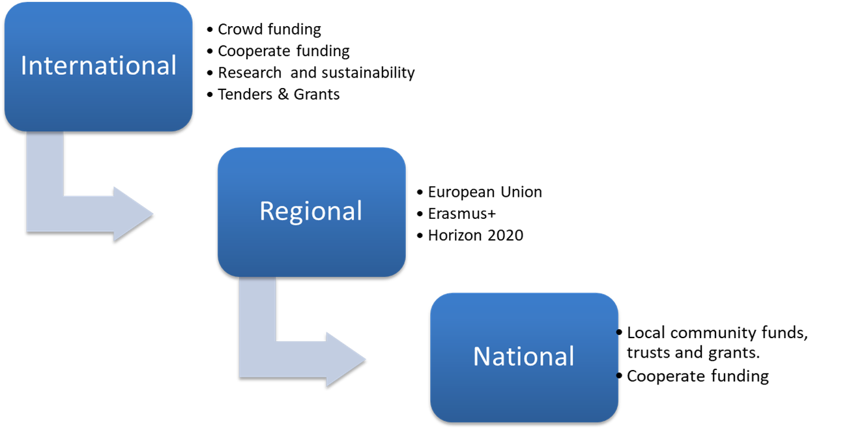
Funding Sources
Public funding can be found at nearly all levels of governement.

Slide 78
Private Funding/ Acquisition of Private Investors
Private equity is an alternative investment class and consists of capital that is not listed on a public exchange. Private equity is composed of funds and investors that directly invest in private companies, or that engage in buyouts of public companies, resulting in the delisting of public equity.
Institutional and retail investors provide the capital for private equity, and the capital can be utilized to fund new technology, make acquisitions, expand working capital, and bolster and solidify a balance sheet.

Slide 79
Types of Private Equity
Leveraged buyouts – Most private equity investment takes the form of a leveraged buyout, i.e. buying out a company entirely with the intention of improving its value and reselling it for a profit or conducting an IPO.
Distressed funding – Sometimes referred to as “vulture financing”, distressed funding refers to investment in troubled companies that have underperforming assets or business units. After making the necessary changes, the private equity firm will sell the business for a profit.
Venture capital funding – Venture capital is a type of private equity that is predominantly focused on early-stage investments with excellent financial potential.
Growth capital – Growth capital is usually focused on stable organisations that are undergoing a period of expansion, whether that’s developing new products or expanding into a new market.

Slide 80
How it works
Raising funds – Private equity investors will raise capital to form a private equity fund. Once this money has been raised, the fund will be closed to new investors.
Conducting research – Next, the private equity fund manager will identify and research a portfolio of private companies that the fund will invest in, hoping to generate a capital profit from the sale of the investment.
Improving operations – This is the most important step in the process. The private equity firm will aim to improve efficiency, boost cash flow, reduce costs, and grow the business, taking a hands-on approach by advising on strategy and development, making introductions with potential customers, and acting as a general business partner.
Selling the portfolio – The final step is for the private equity firm to realise the increased value of their stake in the business by selling it

Slide 81
Credit Financing
Credit is generally defined as an agreement between a lender and a borrower.
Credit also refers to an individual's or business's creditworthiness or credit history.
In accounting, a credit may either decrease assets or increase liabilities as well as decrease expenses or increase revenue.

Slide 82
How do Credit Cards work
A credit card is a physical card that can be used to make purchases, pay bills or depending on the card, withdraw cash. The simplest way to think of a credit card is as a type of short-term loan. When you open a credit card account, your credit card company gives you a set credit limit. This is essentially an amount of money the credit card company allows you to use to make purchases or pay bills.
Credit cards, on the other hand, can impact your credit score directly. FICO credit scores, for instance, calculate your scores based on:
Payment history
Credit usage
Credit age
Credit mix
Inquiries for new credit
Making credit card payments on time can help your score while paying late could hurt it. Similarly, keeping a low balance compared to your credit limit can have a positive impact while maxing out your card limits can detract from your score.

Slide 83
Loans
A loan is when money is given to another party in exchange for repayment of the loan principal amount plus interest.
Loan terms are agreed to by each party before any money is advanced.
A loan may be secured by collateral such as a mortgage or it may be unsecured such as a credit card.
Revolving loans or lines can be spent, repaid, and spent again, while term loans are fixed-rate, fixed-payment loans.

Slide 84
Selected examples of loan options
LOAN TYPE | TYPICAL AMOUNTS, TERMS, AND RATES | BEST FOR
Term loans | Up to $600,000; about 1 – 5 years; 7% – 30% | Variety of business owners across different purposes; faster processes and fewer requirements than traditional bank loans
Business lines of credit | Up to $250,000; up to 2 years; 7% – 25% | Business owners who want a flexible form of financing to cover more immediate funding needs
SBA loans | Up to $5 million; 5 – 25 years; variable based on the prime rate | Established businesses with strong financials who need funding for a variety of purposes
Equipment financing | Up to the amount of the equipment; 5 – 6 years; 4% – 40% | Business owners looking for funding specifically to purchase physical equipment
Invoice financing | Up to 100% of the invoice value; until the customer pays the invoice; about 3% processing fee, plus factor fee (~1%) each week until the invoice is paid | Business owners with unpaid invoices who need an advance of capital to cover cash flow or other short-term financing needs
Commercial real estate loans | Up to the amount of the property; up to 25 years; 5% – 30% | Business owners looking to finance purchasing new or existing commercial property or renovating commercial space
Microloans | Up to $50,000; up to 6 years; starting at around 7% | New or established businesses looking for a small amount of capital
Personal loans for business use | Up to $35,000; 3 – 5 years; 5.99% – 35% APR | Newer businesses who are just starting out and need access to affordable financing
Merchant cash advances | Up to $250,000; paid daily via your merchant account; factor fee of 1.14 – 1.18 | Businesses that can’t qualify for other types of financing; access to fast (but expensive) capital
https://www.fundera.com/business-loans/guides/types-of-business-loans

Slide 85
Assessment
Explain how credit and credit cards are working. And what risks you could run into.
Give three examples of different types of loans and explain them.
In which three levels can a company find public financing?

