Slide 1
Corporate Social Entrepreneurship and Project Management III Part
This programme has been funded with support from the European Commission.
Project No: 612464-EPP-1-2019-1-IE-EPPKA2-KA
VilniusTech team, 2022

Slide 2
Structure of Corporate Social Entrepreneurship (CSE) and Project Management
1 PART Introduction to CSE and project management course: course overview, skills, study load, didactical form, assessment methods
2 PART Theoretical content about project management
3 PART Project scope management
4 PART Agile approaches and techniques in project management
5 PART Leadership & Team Leadership
6 PART Corporate social entrepreneurship practice: Lithuanian case analysis
2

Slide 3
3 PART Project scope management Processes (based on PMBOK GUIDE, 2017)
Knowledge Area | Definition | Planning Process Group | Monitoring and Controlling Process Group
Project Scope Management | Project scope management refers to the total amount of work that must be done in order to deliver a product, service, or result with specified functions and features. | Plan scope management Collect requirements Define scope Create WBS | Validate scope Control scope
Plan scope management: the process of creating a scope management plan; the document helps in defining, managing, validating, and controlling the project’s and product’s scope.
Collect requirements: the process of determining, documenting, and managing stakeholder needs, and requirements to meet project objectives. This information can be gathered through focus groups, interviews, or surveys, and by creating prototypes.
Define scope: the process of developing a detailed description of the project and product.
Create WBS: the process of subdividing project deliverables and project work into smaller components for efficient management.
Validate scope: the process of formalizing acceptance of the completed project deliverables.
Control scope: the process of monitoring the status of the project and product scope and managing changes to the scope baseline.
More about:
Project Management Institute. 2017. A guide to the project management body of knowledge: PMBOK GUIDE. Sixth Edition, Project Management Institute Inc.
3

Slide 4
3 PART Project scope management Collect requirements (based on PMBOK GUIDE, 2017)
Collect requirements: the process of determining, documenting, and managing stakeholder needs, and requirements to meet project objectives.
This information can be gathered through focus groups, interviews, or surveys, and by creating prototypes.
Input:
Project charter
Project management plan
Project documents
Business documents (Business case)
Agreements
Organisation environmental factors
Organisational process assets
Tools & Techniques:
Expert gathering
Data gathering
Data analysis
Decision making
Data representation
Interpersonal and team competencies
Context diagram
Prototypes
Outputs:
Requirements documentation
Requirements traceability matrix
More about:
Project Management Institute. 2017. A guide to the project management body of knowledge: PMBOK GUIDE. Sixth Edition, Project Management Institute Inc.
4

Slide 5
3 PART Project scope management Data gathering techniques: Quantitative and Qualitative analysis
Comparative aspect | Difference
Numbers vs. words | Quantitative research applies measurement procedures to social life while qualitative researchers are seen as using words in the presentation of analyses of society.
Point of view of researcher vs. points of view of participants | In quantitative research, the investigator is in the main place (the set of concerns that they bring to an investigation structure); in qualitative research, the perspective of those being studied (what they see as significant) provides the point of orientation.
A researcher is distant vs. researcher is close | In quantitative research, researchers are uninvolved with their subjects (for example, postal questionnaires, hired interviewers), and may have no contact with them at all; the qualitative researcher seeks close involvement with the people being investigated so that they could understand the world through their eyes.
Theory and concepts tested in research vs. theory and concepts emergent from data | In quantitative analysis, theoretical work precedes the collection of data; in qualitative research, concepts and theoretical elaboration emerge out of data collection.
Static vs. process | Quantitative research is frequently depicted as presenting a static image of social reality with its emphasis on relationships between variables; qualitative research is often depicted as attuned to the unfolding of events over time and to the interconnections between the actions of participants in social settings.
Structured vs. unstructured | Quantitative research is typically highly structured; in qualitative research, the approach is invariably unstructured so that the possibility of getting at actors’ meanings and of concepts emerging out of data collection is enhanced.
More about:
Bryman, A., Bell, E. (2015). Business research methods, Oxford: Oxford University Press, 778 p.
Davidavičienė, V. et al. (2018). Modernizing the academic teaching and research environment: methodologies and cases in business research. Cham: Springer International Publishing.
5

Slide 6
3 PART Project scope management Data gathering techniques: Quantitative and Qualitative analysis
Comparative aspect | Difference
Generalization vs. contextual understanding | Quantitative researchers want their findings to be generalizable to the relevant population; the qualitative researcher seeks an understanding of behaviour, values, beliefs in the context in which the research is conducted.
Hard, reliable data vs. rich, deep data | Quantitative data are often depicted as ‘hard’ in the sense of being robust and unambiguous, owing to the precision offered by measurement; qualitative researchers claim that their contextual approach and their often prolonged involvement in a setting engender rich data.
Macro vs. micro | Quantitative researchers are often depicted as involved in uncovering large-scale social trends and connections between variables, whereas qualitative researchers are seen as concerned with small-scale aspects of social reality, such as interaction.
Behaviour vs. meaning | Quantitative research is concerned with people’s behavior; qualitative research with the purpose of action.
Artificial settings vs. natural settings | Quantitative researchers conduct research in a contrived context; qualitative researchers investigate people in natural environments.
More about:
Bryman, A., Bell, E. (2015). Business research methods, Oxford: Oxford University Press, 778 p.
Davidavičienė, V. et al. (2018). Modernizing the academic teaching and research environment: methodologies and cases in business research. Cham: Springer International Publishing.
6

Slide 7
3 PART Project scope management Date gathering techniques: Advantages and Disadvantages
Method | Definition | Advantages | Disadvantages
Observation | The systematic process of recording and gathering data by watching different research object (people behaviour, events, situations, environment and etc.). | Access to situations and people where other research methods are difficult to use; access to people in real life; proper method for explaining environmental context information. | The difficulty of waiting for long periods to capture the relevant phenomena; the expense of observer costs and equipment; the problems of quantification and disproportionately large records; time consuming.
Experiment | A research investigation in which the researcher has complete control over one set of variables and manipulates the others. | The ability to uncover causal relationships; provisions for controlling extraneous and environmental variables; convenience and low cost of creating test situations rather than searching for their appearance in business situations; the ability to replicate findings and thus rule out idiosyncratic or isolated results; the ability to exploit naturally occurring events. | It is challenging to design experiments to present a specified population; it is difficult to choose the ‘control’ variables to exclude all confounding variables; the experiment is an unnatural social situation with differentiation of roles; experiments cannot capture the diversity of goals, objectives and service inputs which may contribute to outcomes in natural settings.
Questionnaires | Include all methods of data collection in which each person is asked to respond to the same set of questions in a predetermined order. | Can be collected large amounts of information from a large number of people in a short period of time; the results of the questionnaires can be quickly and easily quantified; can be analysed more objectively than other research methods; economical and anonymity aspects. | Lack of personal contact (the researcher is not able to establish a personal relationship with the respondents); level of understanding (respondents may read differently into each question and reply based on their own interpretation of the question); time-consuming.
More about:
Davidavičienė, V. et al. (2018). Modernizing the academic teaching and research environment: methodologies and cases in business research. Cham: Springer International Publishing.
7

Slide 8
3 PART Project scope management Date gathering techniques: Advantages and Disadvantages
Method | Definition | Advantages | Disadvantages
Interview | A purposeful conversation between two or more people, requiring the interviewer to establish rapport, to ask concise and unambiguous questions, to which the interviewee is willing to respond, and to listen attentively. | Development of relationship; selection of suitable candidate; collection of primary and sufficient information; time saving; increasing knowledge. | Record problems; lack of attention; time consuming; personal aspects (personal matters may not be revealed by interview method).
Focus group | A group interview that focuses upon a particular issue, product, service or topic by encouraging discussion amongst participants and the sharing of perceptions in an open and tolerant environment. | Interaction and deepness; intelligibility; non-verbal aspect; time saving; variety points of view. | The researcher has less control over proceedings than with the individual interview; the data are difficult to analyse; they are difficult to organize; the recordings more time-consuming to transcribe than equivalent recordings of individual interviews; there are possible problems of group effects.
Case studies | Investigates a contemporary phenomenon (the “case”) in its real world context, especially when the boundaries between phenomenon and context may not be clearly evident. | Case study is based on people’s competencies, own experiences and practices and it is main factor for learning process; case studies allow to present the complexity of social life; is possible to collect detailed information. | The complexity of a case can make analysis more difficult; case studies provide little basis for scientific generalisation; case studies difficult to conduct and it is difficult to manage and organise data systematically.
More about:
Davidavičienė, V. et al. (2018). Modernizing the academic teaching and research environment: methodologies and cases in business research. Cham: Springer International Publishing.
8

Slide 9
3 PART Project scope management Date gathering techniques: Observation
Observation is the systematic process of recording and gathering data by watching different research objects (people behaviour, events, situations, environment and etc.).
Observations can be overt (people know they are being observed) and covert (people don’t know that they are being observed).
Spatial use of sites (including workplaces, retail areas, public areas such as roads or urban precincts, and recreational spaces, such as parks, beaches) method can be used to examine how space is used, the level of use of particular areas, traffic flow, and the movement of material and people. The movement of people within an area can be recorded for later analysis by using various ICT.
Workplace behaviour allows a range of workplace behaviours to be examined. It is possible to observe an individual’s physical actions, non-verbal behaviours (such as tone of voice or body language) and the time taken to perform tasks, as well as physical distances between people at work. Finding out about such things requires observation ­­– sometimes covert observation. This may raise employee relations issues and ethical issues concerning people’s rights to privacy.
Consumer testing is under-exploited use of observation, sometimes referred to as ‘mystery shopping. While interviews are the most common means of obtaining information on the quality of the experience offered by, for example, shopping center, an additional means is for the researcher to play the role of an incognito customer and analyse, for example, information availability and clarity, product availability, staff courtesy, knowledge.
Social behaviour observation has been used in sociological analysis to develop ideas about social behaviour. Researchers use an interactive and inductive process to build explanations of social behaviour from what they observe.
More about:
Veal, A. J. (2005). Business research methods: a managerial approach, Frenchs Forest: Pearson Education Australia, 362 p.
Davidavičienė, V. et al. (2018). Modernizing the academic teaching and research environment: methodologies and cases in business research. Cham: Springer International Publishing.
9

Slide 10
3 PART Project scope management Observation: 4 types of participant observation
Complete participant: role sees you as the researcher attempting to become a member of the group in which you are performing research, who operates covertly, concealing any intention to observe the setting.
Participant-as-observer: the researcher would both take part and reveal the purpose as a researcher; participant-as-observer forms relationships and participates in activities but makes no secret of an intention to observe events.
Observer-as-participant: an identity as a researcher would be clear to all concerned and they would know the purpose of research; observer-as-participant maintains superficial contacts with the people being studied.
Complete observer: researcher wouldn’t take part in the activities of the group, merely stands back and eavesdrops on the proceedings.
More about:
Davidavičienė, V. et al. (2018). Modernizing the academic teaching and research environment: methodologies and cases in business research. Cham: Springer International Publishing.
10

Slide 11
3 PART Project scope management Observation: main dimensions
Main dimensions in relation to which data can be gathered:
Space – the researcher has to describe the physical place in which operating (what does it look like, feel like);
Actors – who is the researcher observing, what are their personalities and profiles, what relationships exist between actors;
Activities – what is taking place in the setting, who is doing what with whom;
Objects – what objects are present in the research setting and what role do they play in relation to the actors;
Motivation and goals – what are the actors moving towards, what is motivating them;
Feelings – how do actors behave, what are emotions.
More about:
Stokes, P., Wall, T. (2014). Research methods, London: Palgrave Macmillan, 284 p.
Davidavičienė, V. et al. (2018). Modernizing the academic teaching and research environment: methodologies and cases in business research. Cham: Springer International Publishing.
11

Slide 12
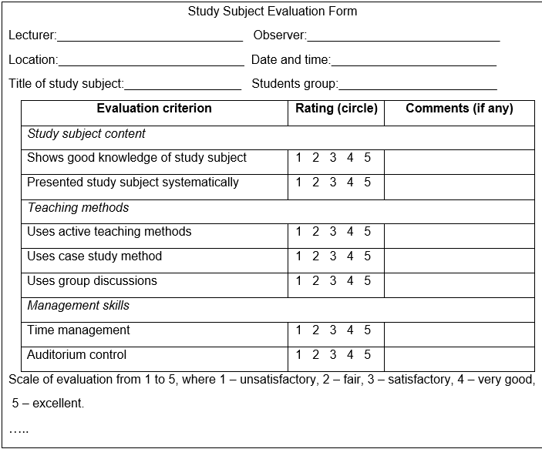
3 PART Project scope management Observation: Example of Observation Form
More about:
Davidavičienė, V. et al. (2018). Modernizing the academic teaching and research environment: methodologies and cases in business research. Cham: Springer International Publishing.
12

Slide 13
3 PART Project scope management Questionnaires: Types of closed-end questions
Type of question | Description | Example
Dichotomous | A question offering to choose from two possible responses. | Do you have experience in collaborating with business companies? Yes No
Multiple choice | A question offering three or more answer choices. | What are the tools, from the given list, you use to conduct research? Computers Internet connection Libraries Laboratories Software (SPSS, STATA)
Likert scale | A bipolar scaling technique, which allows a respondent to select choice that best demonstrates their level of agreement with a given statement. | Please identify, if academic entrepreneurship factor could help to develop your skills to run scientific research at institution level: 1 Strongly disagree 2 Disagree 3 Neither agree nor disagree 4 Agree 5 Strongly agree
Semantic differential | A multidimensional measure between two bipolar adjectives. | Please evaluate your University: Large X _ _ _ _ _ Small Modern _ X _ _ _ _ Old Experienced _ _ X _ _ _ Inexperienced
More about:
Davidavičienė, V. et al. (2018). Modernizing the academic teaching and research environment: methodologies and cases in business research. Cham: Springer International Publishing.
13

Slide 14
3 PART Project scope management Questionnaires: Types of closed-end questions
Type of question | Description | Example
Importance scale | A scale that rates the importance of some attribute from ‘not at all important’ to ‘extremely important’. | Business research center to me is …: 1 Extremely important 2 Very important 3 Somewhat important 4 Not very important 5 Not at all important
Rating scale | A scale that rates some attribute from ‘poor’ to ‘excellent’. | The working conditions of researchers in my institution are: 1 Excellent 2 Very good 3 Good 4 Fair 5 Poor
Intention-to-buy scale | A scale that describes the respondent’s intentions to buy. | If in business research center internet service were available 24 hours, I would …: 1 Definitely buy 2 Probably buy 3 Not certain 4 Probably not buy 5 Definitely not buy
More about:
Davidavičienė, V. et al. (2018). Modernizing the academic teaching and research environment: methodologies and cases in business research. Cham: Springer International Publishing.
14

Slide 15
3 PART Project scope management Questionnaires: Types of open-end questions
Type of question | Description | Example
Completely unstructured | A question in which respondents can answer in unlimited number of ways. | What is your opinion of business research center? _________________________________________________ _________________________________________________
Word association | Words are presented one at a time, and respondents mention the first word that comes to mind. | What the first word comes to your mind when you hear the following words? Business ________ Research________ Center __________
Sentence completion | Incomplete sentences are presented one at a time and respondents complete the sentence. | When I think about barriers, which are stopping to develop my scientific research activities, the most important barrier is: ________________________________________________ ________________________________________________
Story completion | An incomplete story is presented and respondents are asked to finish it. | The goal of a project is to develop entrepreneurship competencies that help creating job opportunities for students. The specific objectives the project shall achieve are the following: understanding the current situation of entrepreneurship environment; developing appropriate training programs; establishing business research center in the business and management fields… Complete the story.
More about:
Davidavičienė, V. et al. (2018). Modernizing the academic teaching and research environment: methodologies and cases in business research. Cham: Springer International Publishing.
15

Slide 16
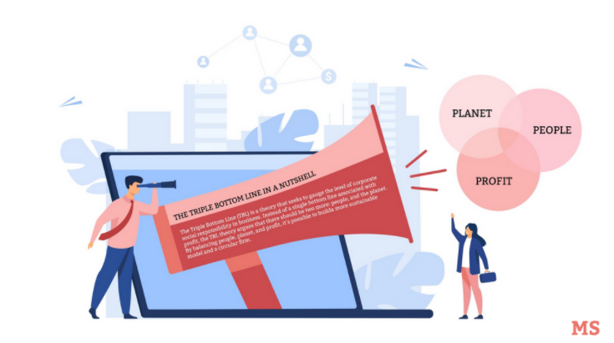
3 PART Project scope management Questionnaires: Types of open-end questions
Type of question | Description | Example
Picture completion | A picture of two characters is presented, with one making a statement. Respondents are asked to identify with the other and fill the empty balloon. | Image from <https://marketsplash.com/social-entrepreneurship/>
Thematic apperception tests | A picture is presented and respondents are asked to create a story about what they think is happening or may happen in the picture. | Create a story about what you see in the picture: Image from <https://ied.eu/project-updates/branding-for-social-enterprises/>
Please fill the empty field.
Here are 3 new principles
More about:
Davidavičienė, V. et al. (2018). Modernizing the academic teaching and research environment: methodologies and cases in business research. Cham: Springer International Publishing.
16

Slide 17
3 PART Project scope management Interview: types
Individual depth interview consists of such types like (Cooper, Schindler, 2011):
Oral history: ask participants to relate their personal experiences and feelings related to historical events or past behaviour;
Cultural interviews: ask a participant to relate his or her experiences with a culture or subculture, including knowledge passed on by prior generations and the knowledge participants have or plan to pass on to future generations;
Life histories: extract from single participant memories and experiences from childhood to the present day regarding a product or service category, brand, or firm;
Critical incident technique: the participant describes what led up to the incident; exactly what he or she did or did not do that was especially effective or ineffective;
Convergent interviewing: experts serve as participants in a sequential series of individual depth interview;
Sequential interviewing: approach the participant with questions formed around an anticipated series of activities that did or might have happened, in order to have the participant recall the detail of his or her own experience;
Ethnography: interviewer and participant collaborate in field-setting participant observation and unstructured interview;
Grounded theory: using a structured interview, each subsequent interview is adjusted based on the findings and interpretations from each previous interview, with the purpose to develop general concepts or theories with which to analyse the data.
More about:
Cooper, D. R., Schindler, P. S. (2011). Business research methods, New York (N.Y.): McGraw-Hill/Irwin, 761 p.
Davidavičienė, V. et al. (2018). Modernizing the academic teaching and research environment: methodologies and cases in business research. Cham: Springer International Publishing.
17

Slide 18
3 PART Project scope management Case study: types
A case study investigates a contemporary phenomenon (the “case”) in its real-world context, especially when the boundaries between phenomenon and context may not be clearly evident. Case study design and data collection features, such as how data triangulation helps to address the distinctive technical condition whereby a case study will have more variables of interest that data points. Among the variations in case studies, a case study can include single or multiple cases, can be limited to quantitative evidence and can be a useful method in doing an evaluation (Yin 2014).
There are five types of case studies (Bryman, Bell 2015):
The critical case where the researcher has a clearly specified hypothesis, and a case is chosen on the grounds that it will allow a better understanding of the circumstances in which the hypothesis will and will not hold.
The unique case – it is the unique or extreme case.
The revelatory case where the basis for this case exists when an investigator has an opportunity to observe and analyse a phenomenon previously inaccessible to scientific investigation.
The representative or typical case seeks to explore a case that exemplifies an everyday situation or form of organization.
The longitudinal case is concerned with how a situation changes over time.
More about:
Yin, R. K. (2014). Case study research: design and methods, fifth edition, SAGE Publications, 265 p.
Bryman, A., Bell, E. (2015). Business research methods, Oxford: Oxford University Press, 778 p.
Davidavičienė, V. et al. (2018). Modernizing the academic teaching and research environment: methodologies and cases in business research. Cham: Springer International Publishing.
18

Slide 19
3 PART Project scope management Questions
What is the purpose of Project scope management?
Based on your experience in project management, which data gathering techniques could be useful in the CSE field?
Interview vs Observation: what are the main advantages and disadvantages of gathering data in the CSE field?
Observation vs Case study: what are the main advantages and disadvantages of gathering data in the CSE field?
What data gathering techniques would be valuable for collecting requirements in the CSE projects?
19

